Slide 1
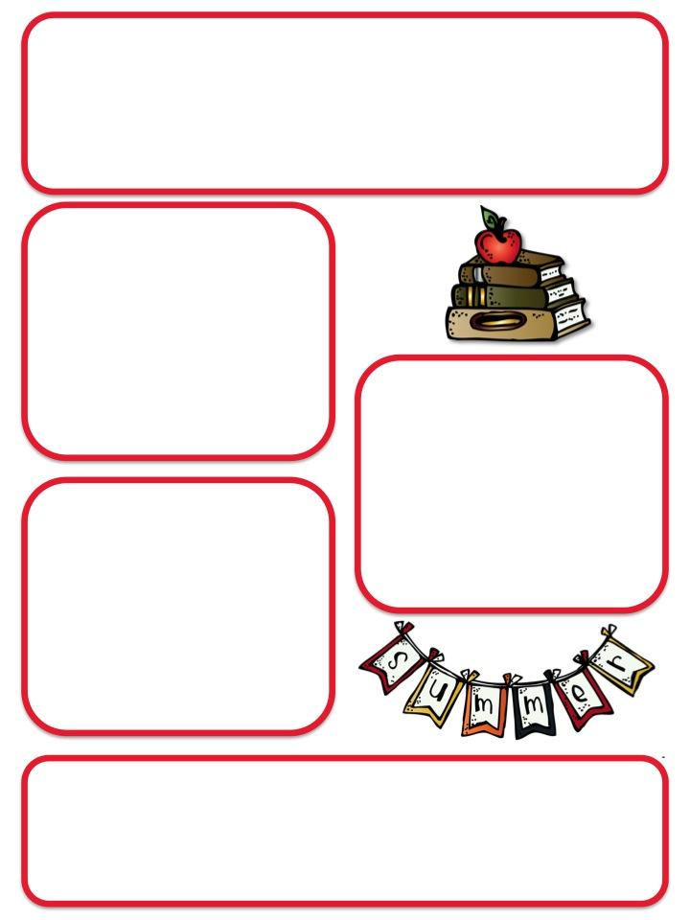
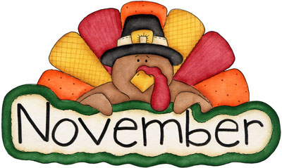
Ms. Mathews’s 3rd grade
November Newsletter
Calendar
November 7: Picture Make-up
Day
November 14: Build It Night
(5:45-7pm in the cafeteria)
November 21: Thanksgiving
Lunch
November 21-22: Science Fair
November 25-29: No School
Fall Festival
Thank you to all the parents who volunteered their time, supplies and money to support our classroom games at the Fall Festival.
Reminders
Students should only bring one snack per day – it should be healthy, no candy or gum.
2. Thursday folders should be returned by Wednesday morning, to the pink basket by the sink, thanks!
Students have been busy thinking and writing about what they are thankful for. I was so impressed to see so many irreplaceable things on their lists. You will see these responses – perhaps on your Thanksgiving table in feathered form, soon!

Slide 2
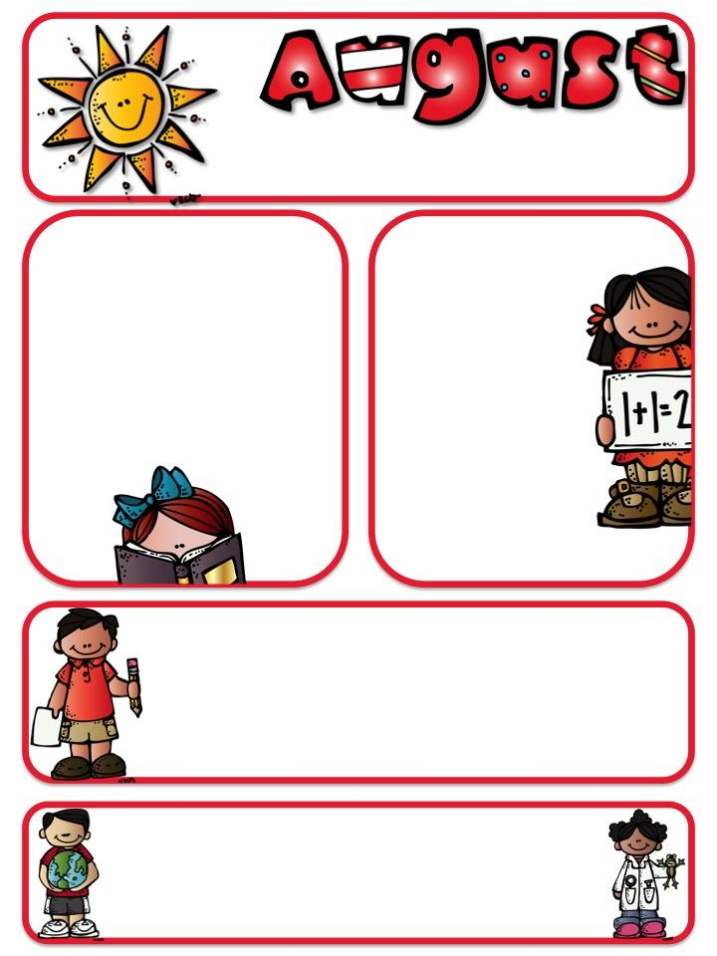
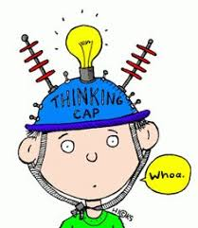
What have we been learning?
Reading Core
This month in Reading Core, we have continued our unit on the power of reading and the power of education. We finished looking at how children around the world access books and have been focusing more on learning challenges. Specifically, we have been reading, writing and discussing how children with learning disabilities are able to overcome those challenges to gain the power to read. This unit is ending and we will be starting our new unit which focuses on non-fiction reading about frogs!
Math
Students in my math class been working on multiplication and division word problems, addition and subtraction with regrouping and estimating to the nearest 10 and 100. These students will continue working on multiplication and division in November.
Writing
Students listened to several stories about giant vegetables (all based on Leo Tolstoy’s The Gigantic Turnip). Students wrote plot summaries, then planned and wrote creative stories based on this familiar plot.
Social Studies/Science
We are near the end of our science unit on life cycles where the students have been learning about the life cycles of plants and animals and environmental factors that can affect them. We will begin our next unit on the solar system, planets and constellations in November. I know many students are excited to start exploring space!

