Slide 1
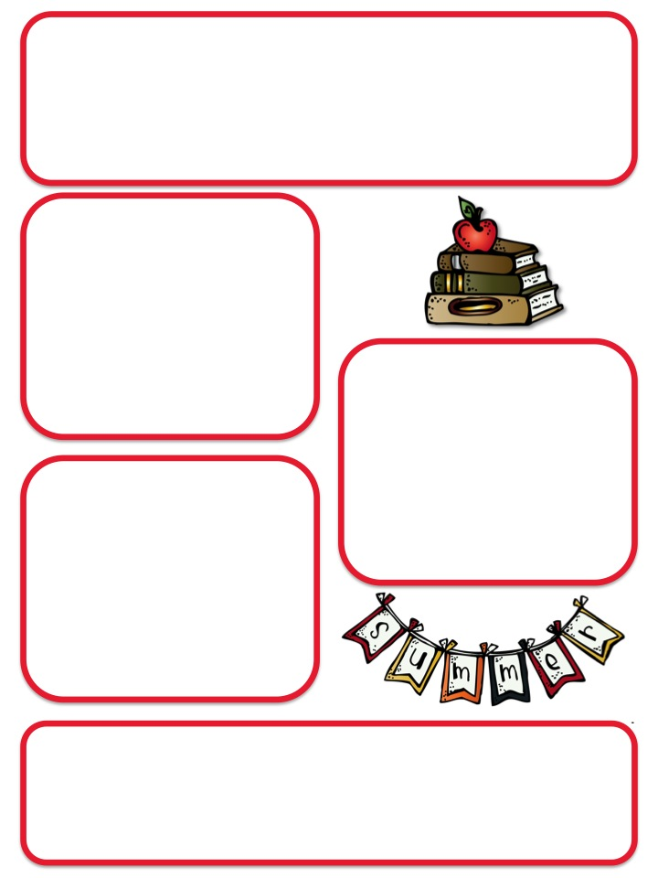
Ms. Mathews’s 3rd grade
December Newsletter
Calendar
December 10-13: Scholastic
Book Fair in Auditorium
December 13: Books & Bagels
(8-8:30 in Auditorium)
December 11: Field Trip
December 13: Book Character
Dress-up Day
December 19: Read-a-Thon
Kick-off Day
December 20: PJ day
Field Trip
On the afternoon of December 11, we are heading up to the mountains for a winter hike! We’ll be exploring the Colorado geography and learning about native plants and animals. In previous years, students have even seen mule deer and bison!
Reminders
Students should only bring one snack per day – it should be healthy, no candy or gum.
Thursday folders should be returned by Wednesday morning, to the pink basket by the sink, thanks!
Students have done such an impressive job on their writing and reading core (writing about reading). Please consider keeping a journal, or writing lists and letters over the long holiday break to keep these great writing skills sharp for the new year!

Slide 2
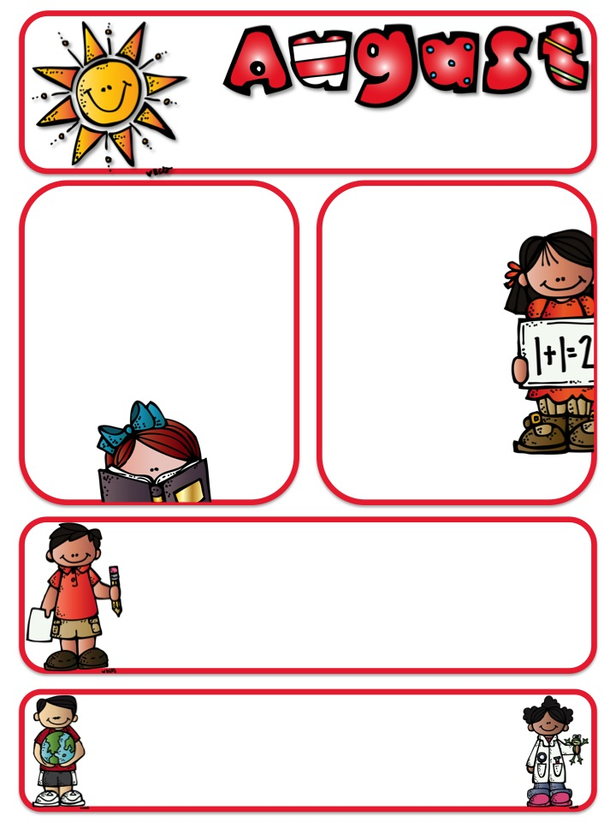
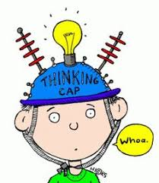
What have we been learning?
Reading Core
Frogs, frogs and more frogs!! This month in Reading Core, we are reading about, analyzing, writing about and discussing different characteristics and adaptations of frogs. This unit will culminate with the students choosing a frog to research and become an expert on and then students will write a narrative from the unique perspective of that frog and create a trading card featuring facts about that frog.
Math
In December, students will be learning division with units of 0, 1, 6-9 and multiples of 10.
In January, students will be focusing on multiplication and area.
Please help your student to memorize multiplication facts up to 12 x 12. This makes math so much easier in upper grades! This is the request of Edison 4th and 5th grade teachers!
Writing
In December, students will be writing personal narratives, exploring topics such as when someone influenced you, memorable holidays, memorable changes, and when you learned a lesson.
Social Studies/Science
We are finished studying life cycles and are now learning about space and various objects in the sky. This includes the Sun, the Moon, the planets and the constellations. In January as we conclude this unit, students will choose a planet or moon to research as a potential new habitat for humans. Students will have to defend (and plan changes for)their choice based on the needs for human existence.

